Slide 1
SIEM
By Christopher Ditto, Carlos Gerez, Mark Riley Slik

Slide 2
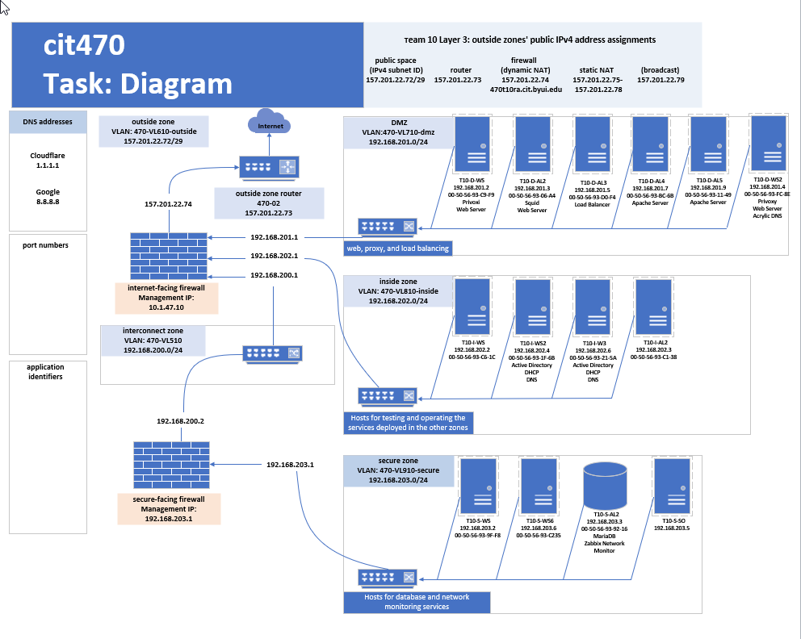

Slide 3
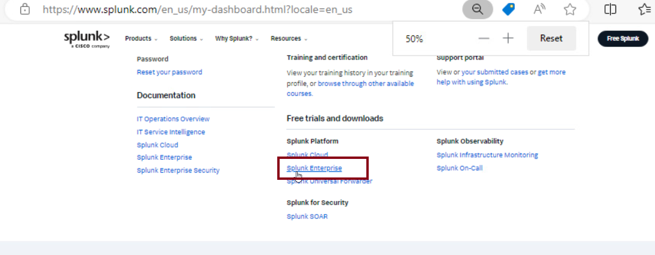
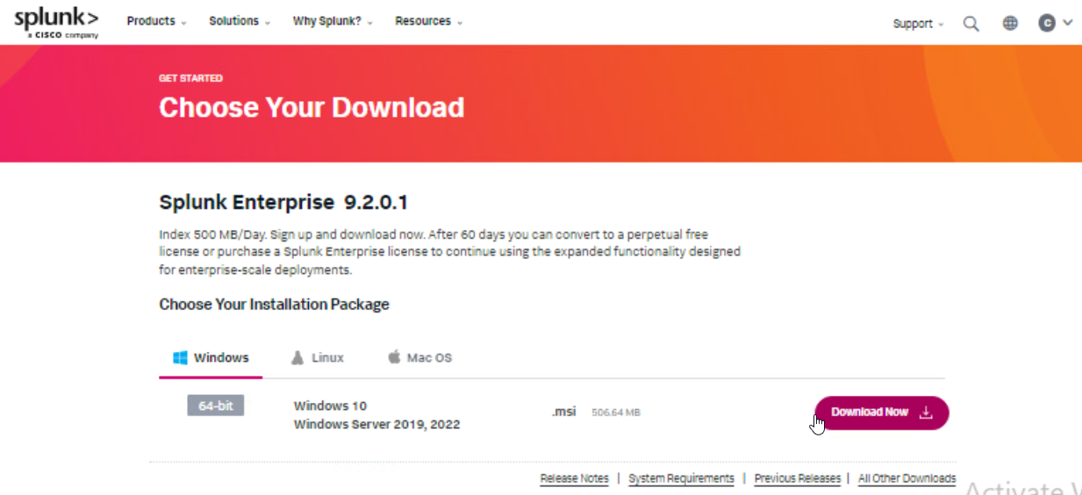
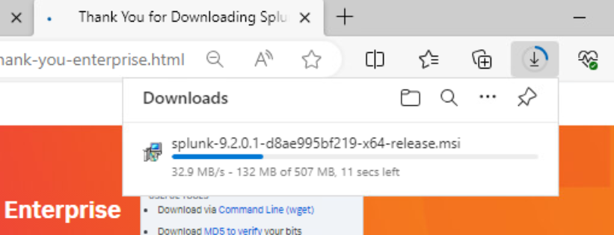
Download Splunk free trial
We need to create an account to use the splunk enterprise software.

Slide 4
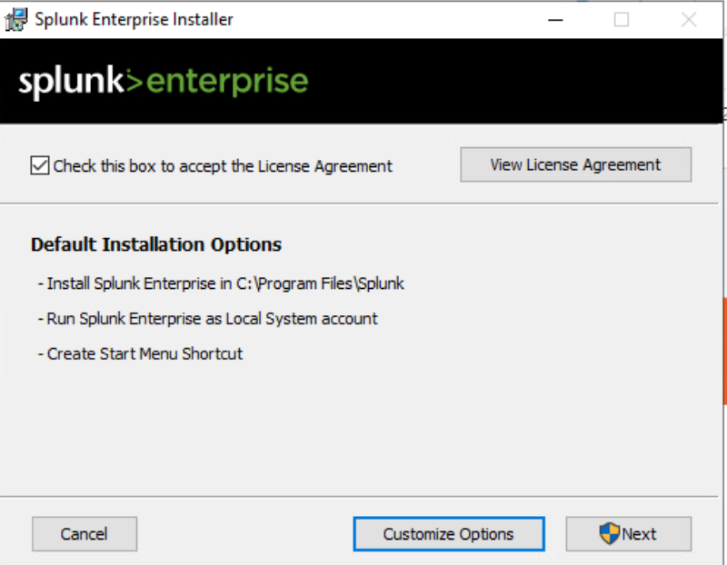
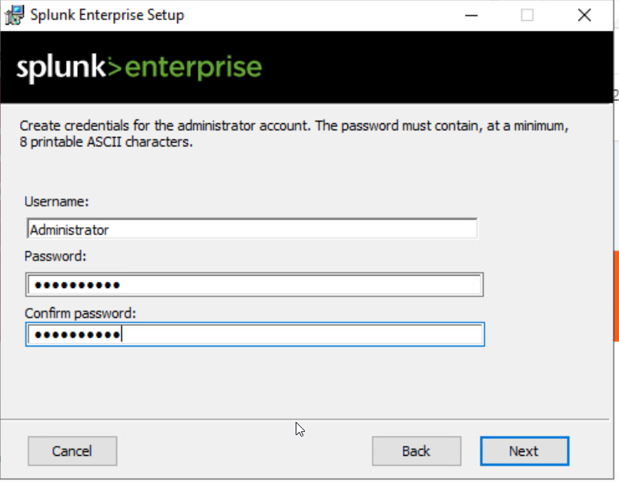
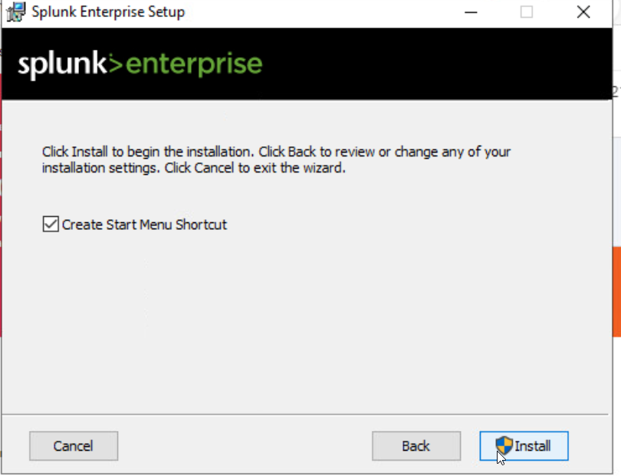
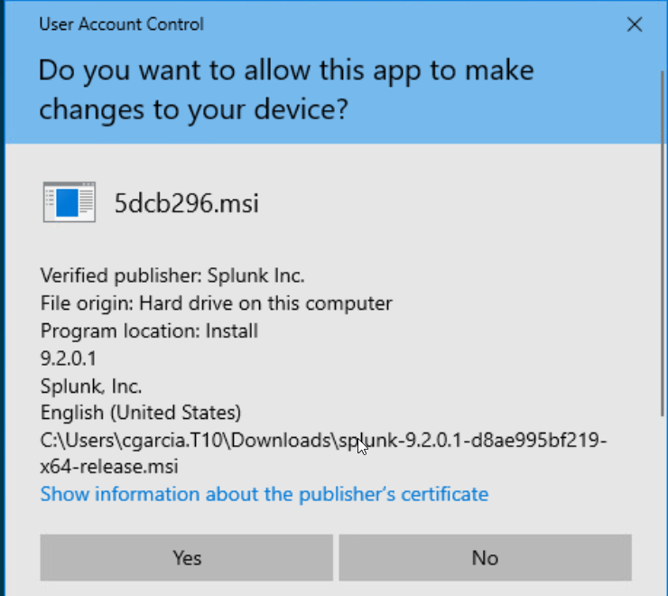
Run the install of splunk and make a user
Follow the guide to install the host, use a username and password. Default installations options will work well.

Slide 5
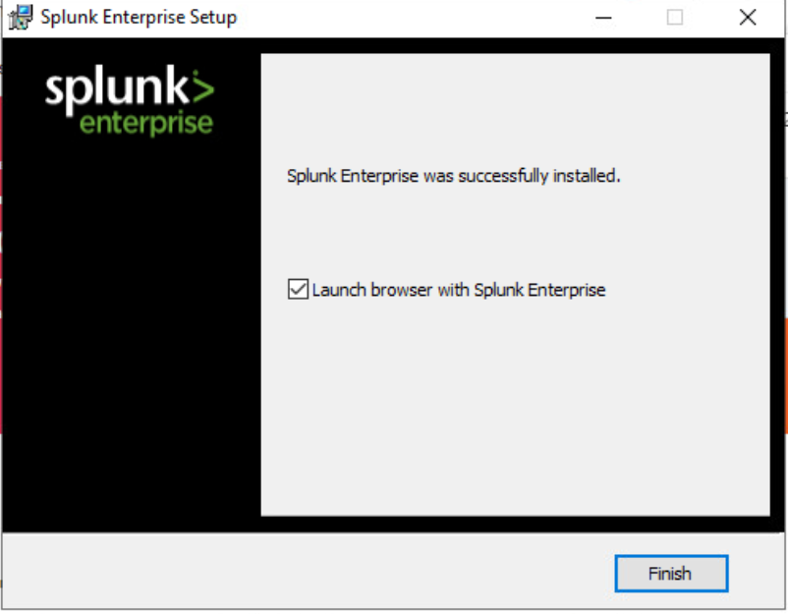
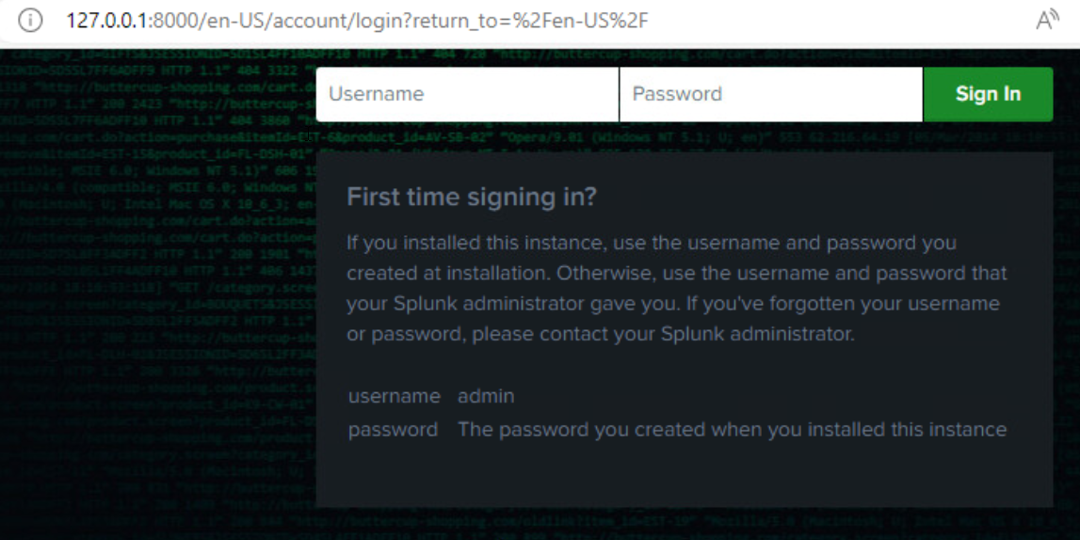
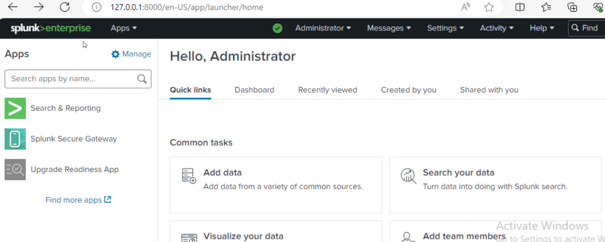
Log in with the username and password you made before.

Slide 6
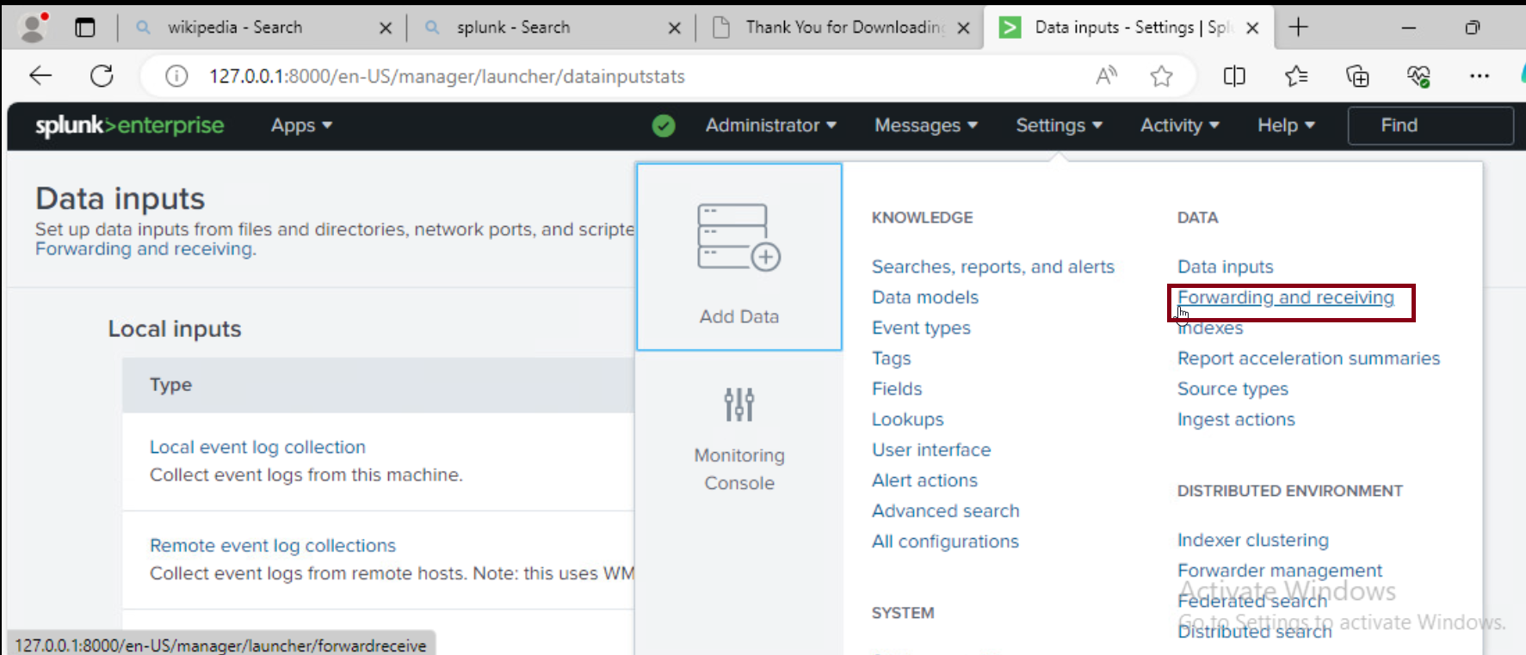
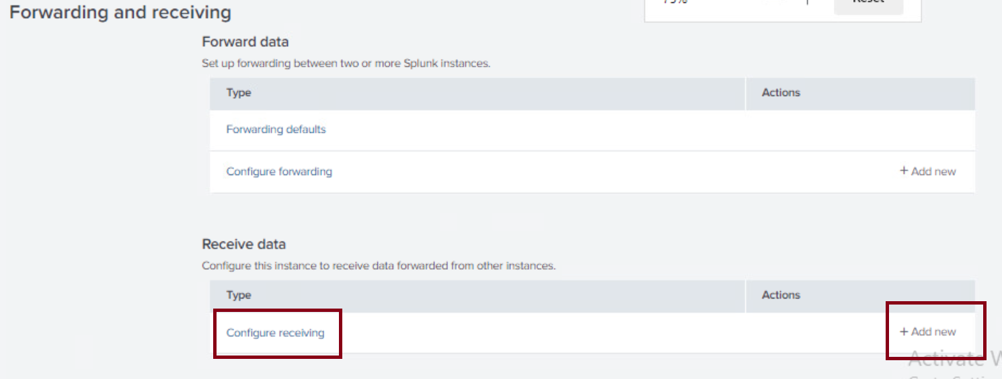
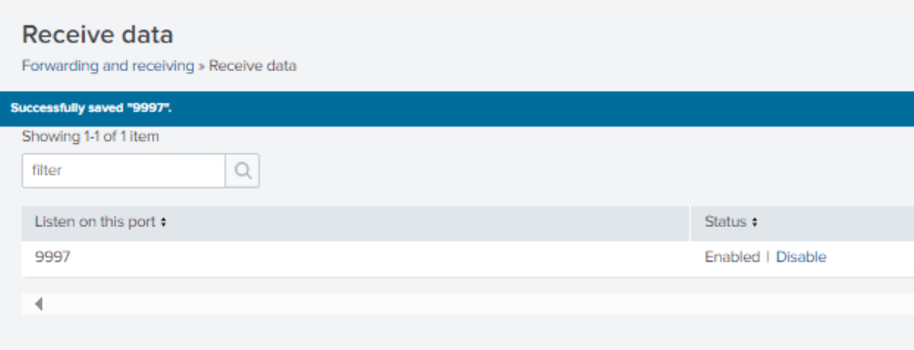
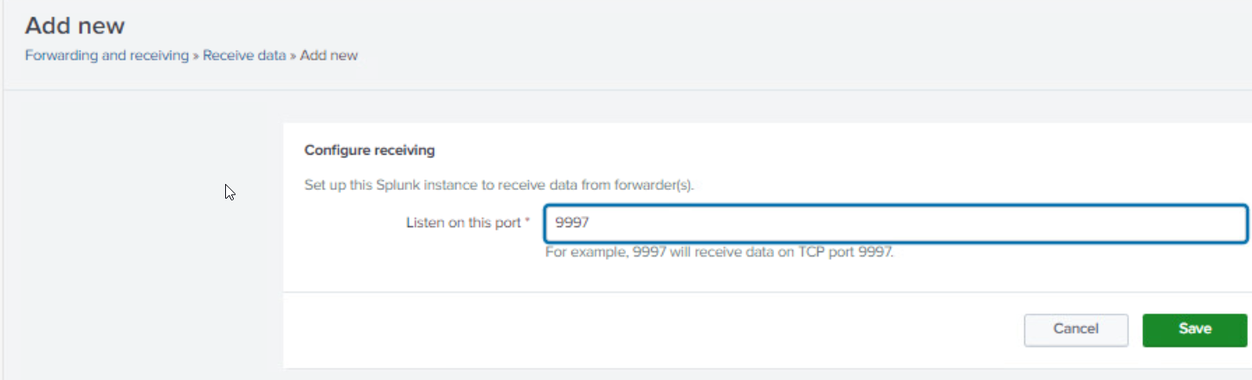
Configure the host to listen from port 9997.
On settings select Forwarding and receiving and add new port default 9997. This setting allows to receive logs from forwarders.

Slide 7
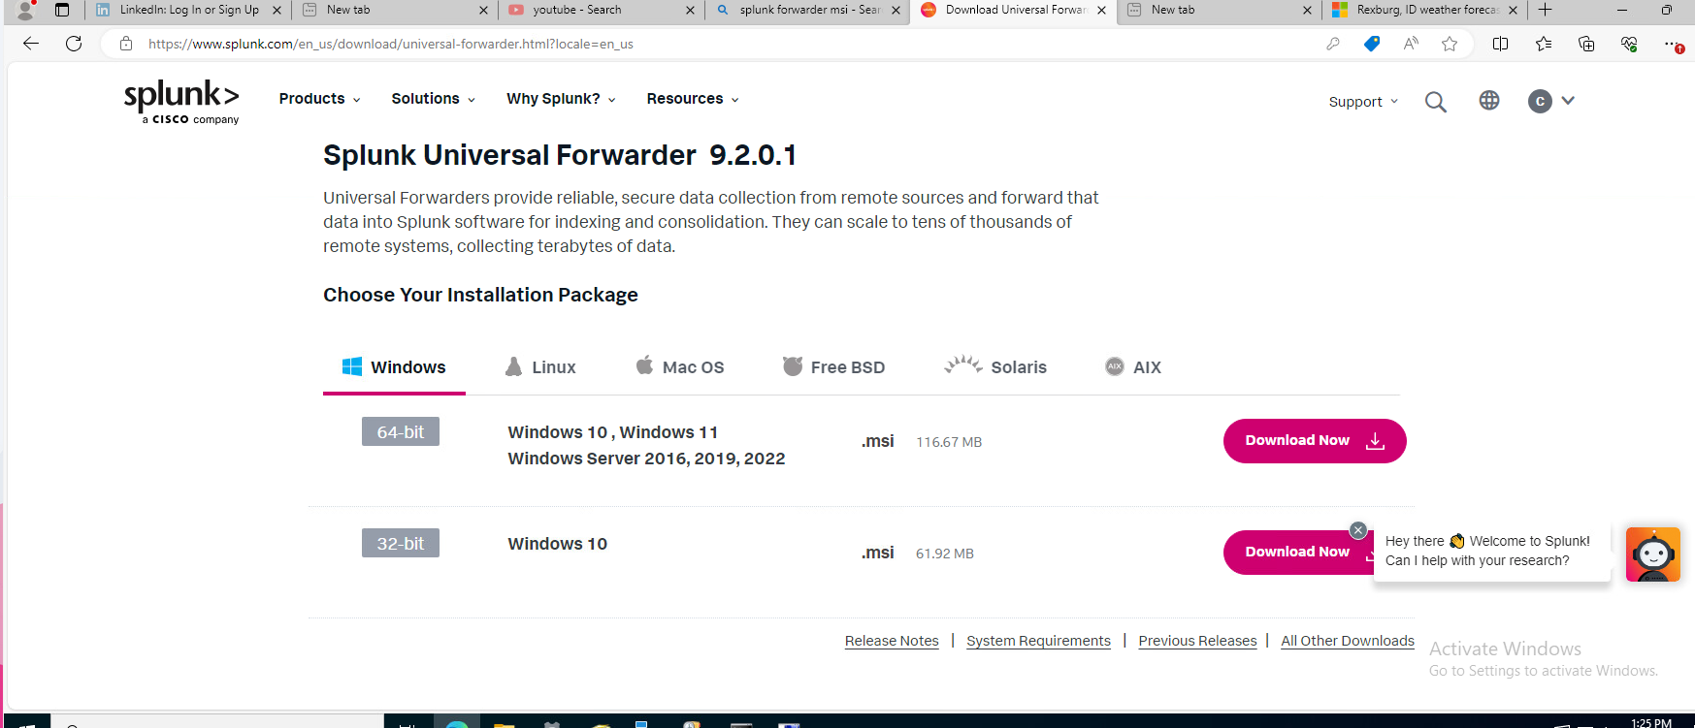
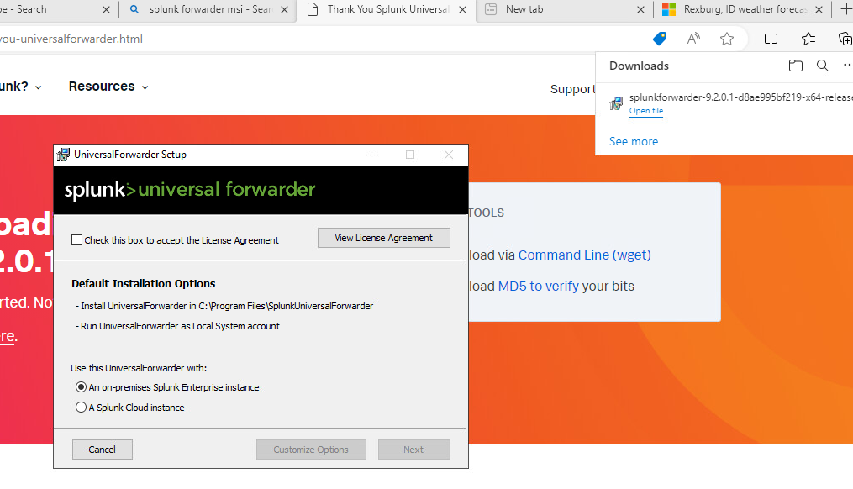
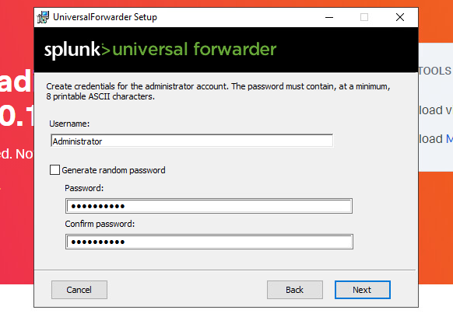
Universal Forwarder configuration on Windows endpoint.
Download forwarder
Follow the guide and fill the prompts.
On Username use the same as in the creation of the host, and the same password.

Slide 8
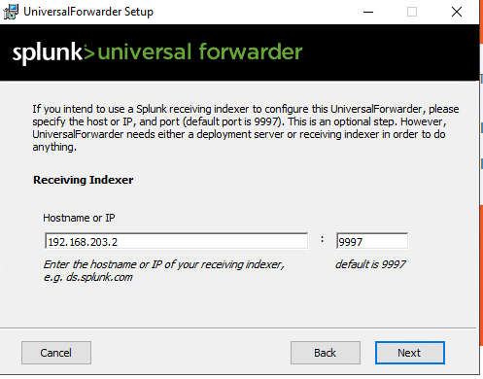
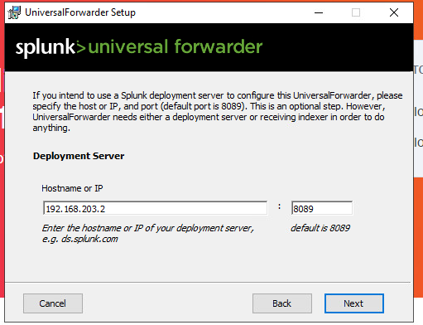
Universal Forwarder configuration on Windows endpoint
On Deployment server hostname use the ip address of the host already created and use the default port 8089.
On Receiving Indexer use the same address as before and the default port 9997.

Slide 9
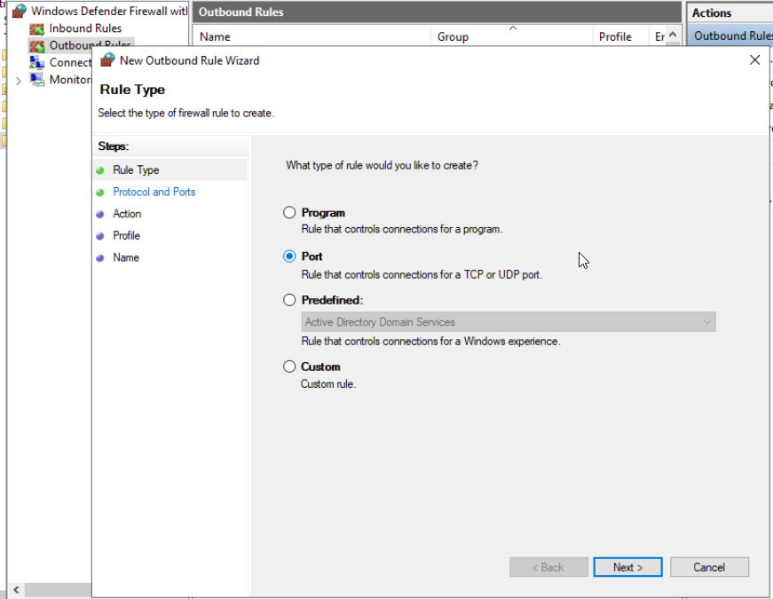
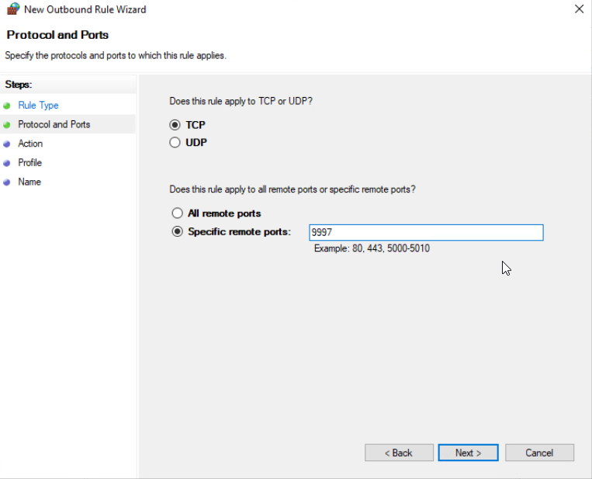
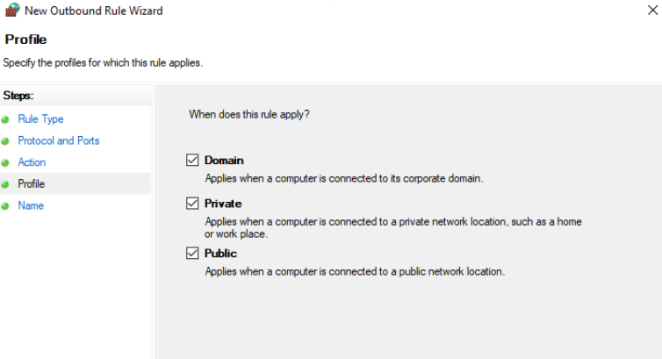
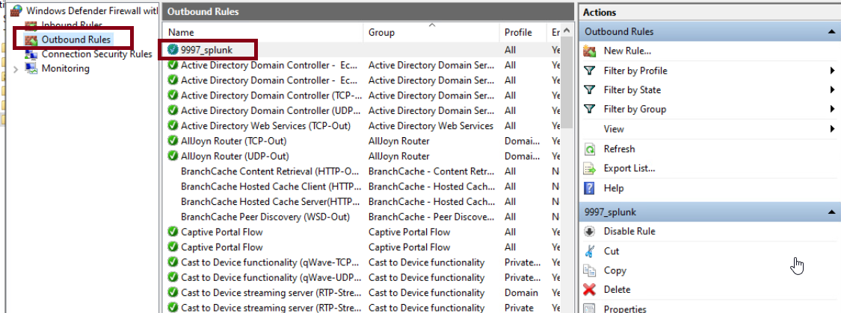
Universal Forwarder configuration Firewall rule on Windows
Add an outbound new rule to allow TCP on port 9997.

Slide 10
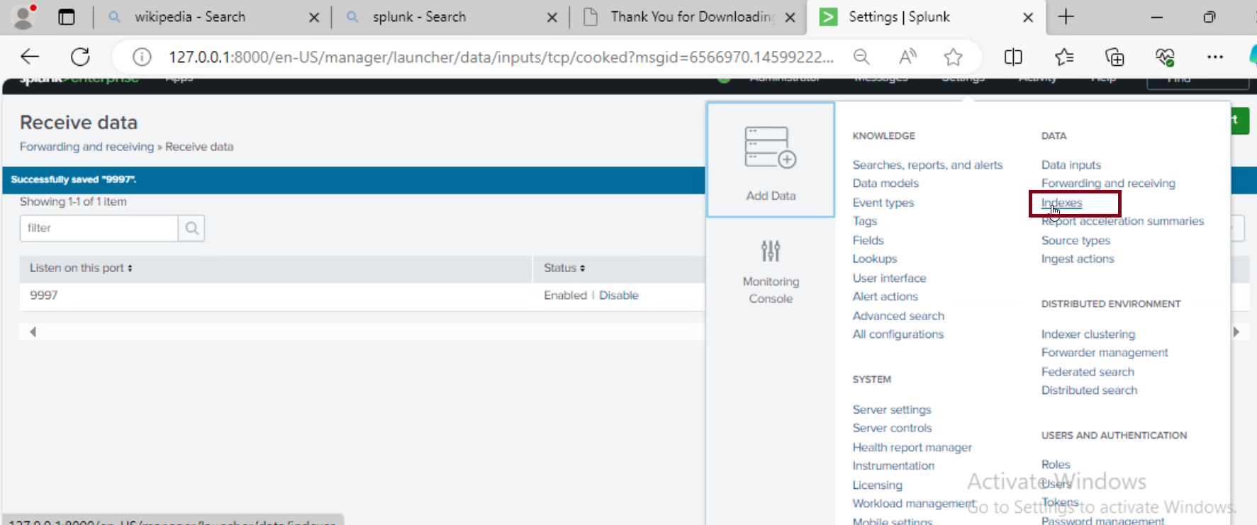
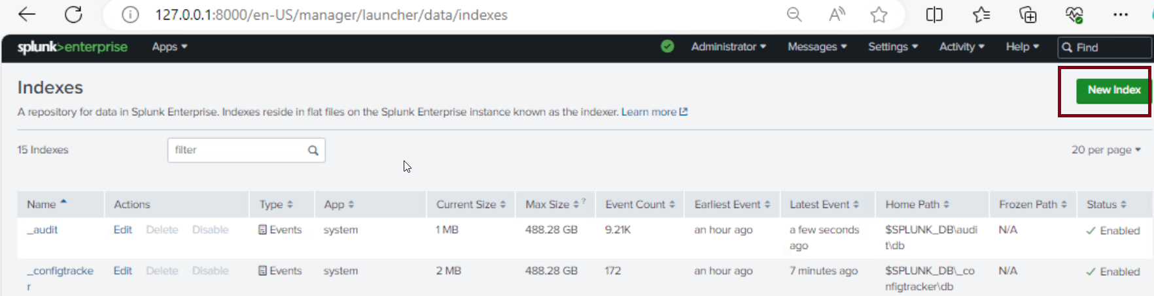
On the host machine create a new index to receive the logs.
After open the web interface with the address 127.0.0.1:8000 and authenticate, under Settings go to Index and create a new index. The index serve as a repository for the logs.

Slide 11
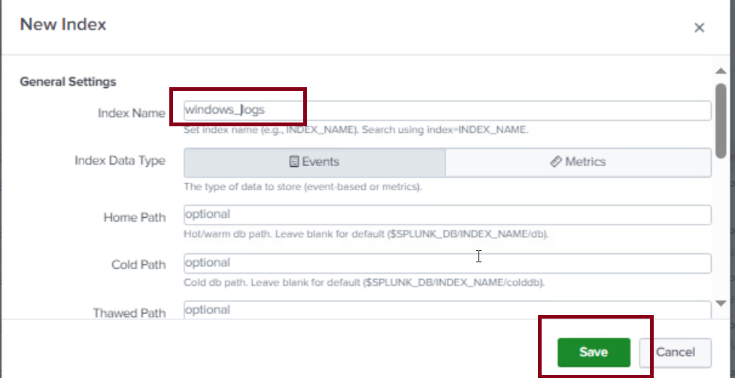
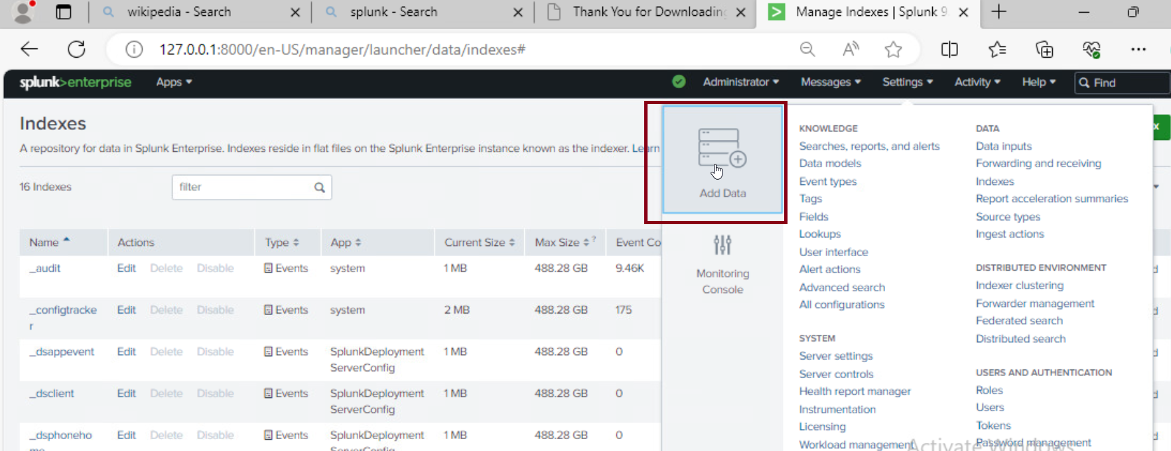
Check that the host receive logs from the forwarder
We give in this example the name windows_logs name and save.
We can start to check that we receive logs from the user by open in settings, Add Data.

Slide 12
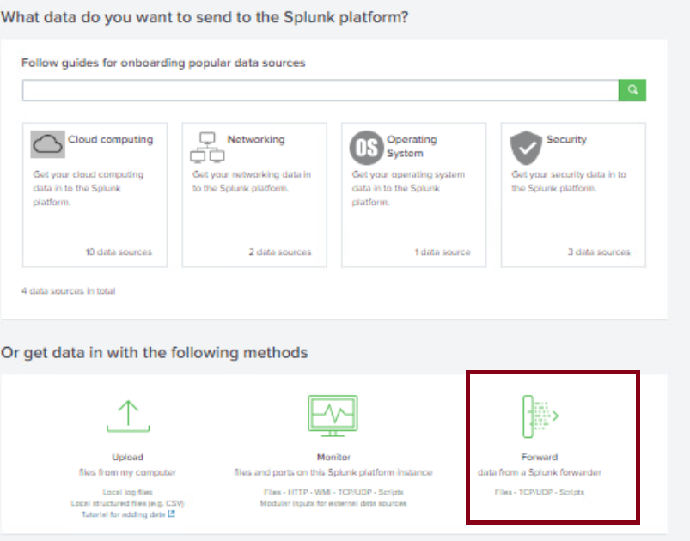
Check that the host receive logs from the forwarder
After we select forward as a receiving method, we should see that the windows machine is sending his first data to us. However we don't see it yet.

Slide 13
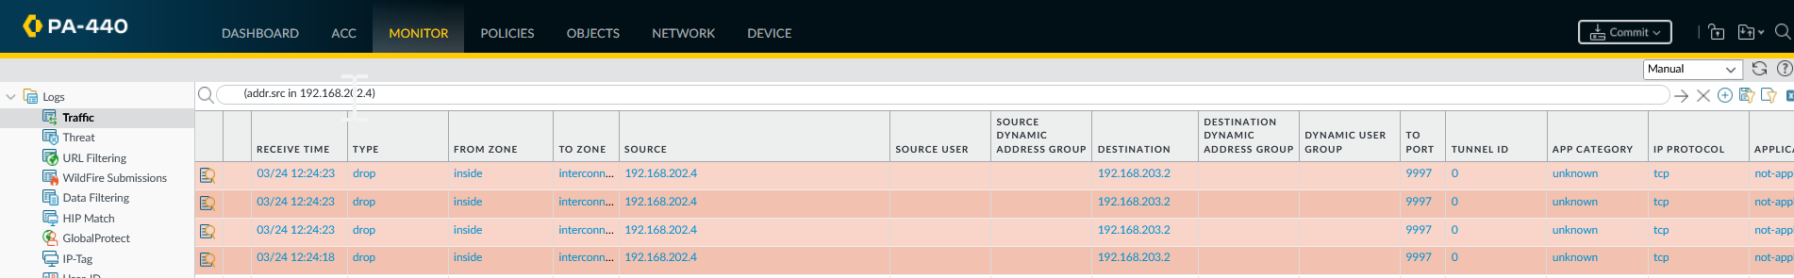
First rules to allow traffic over the firewalls
In the first screenshot we see that the Palo Alto firewall is blocking the packages. Then we made a firewall rule to allow the transfer of those package on Palo Alto and also add a new rule to allow incoming packages on the Fortigate firewall on the secure zone.

Slide 14
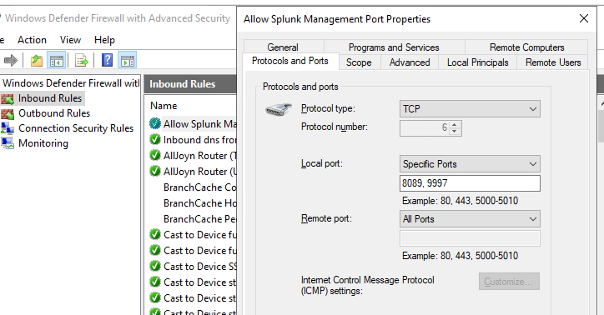
Firewall rules for inbound and outbound on the host.
We also need to add new inbound and outbound rules for the host to allow ports 8089 and 9997 communications.

Slide 15
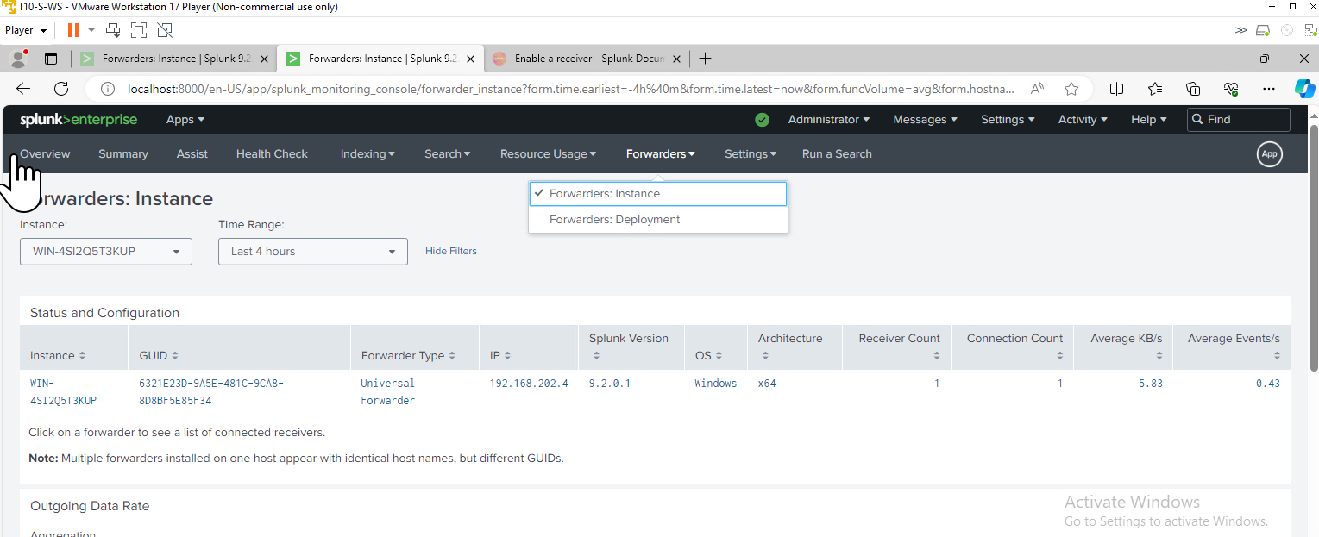
Receiving data from the forwarder.
On settings and forwarders instances appears the windows endpoint that we configure to send data.

Slide 16
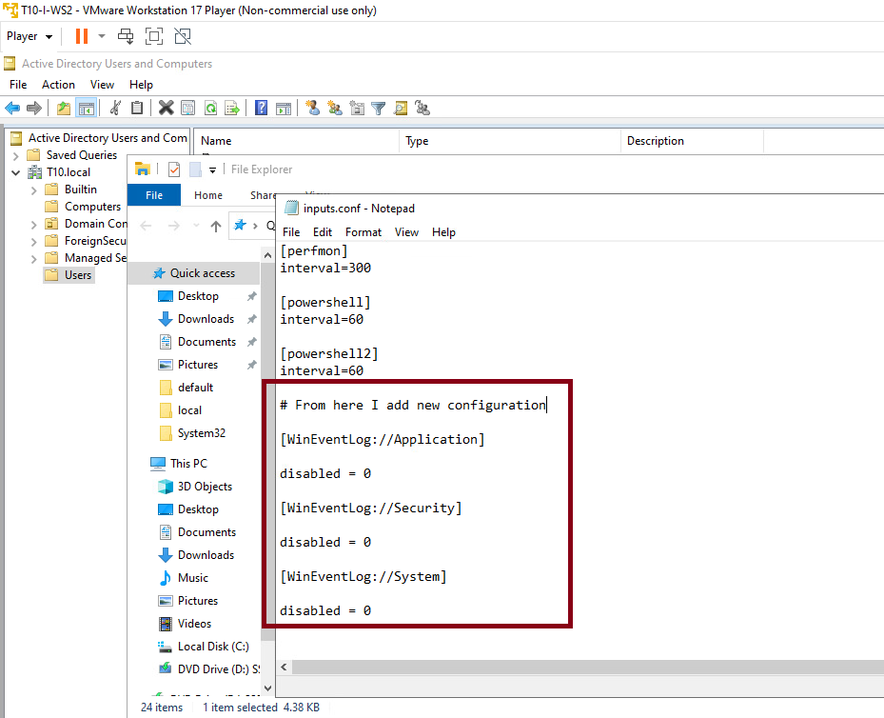
Configuration on inputs.conf on forwarder to send Event Logs
We add the event logs to be sent to the host. Has to restart the service after saving changes.

Slide 17
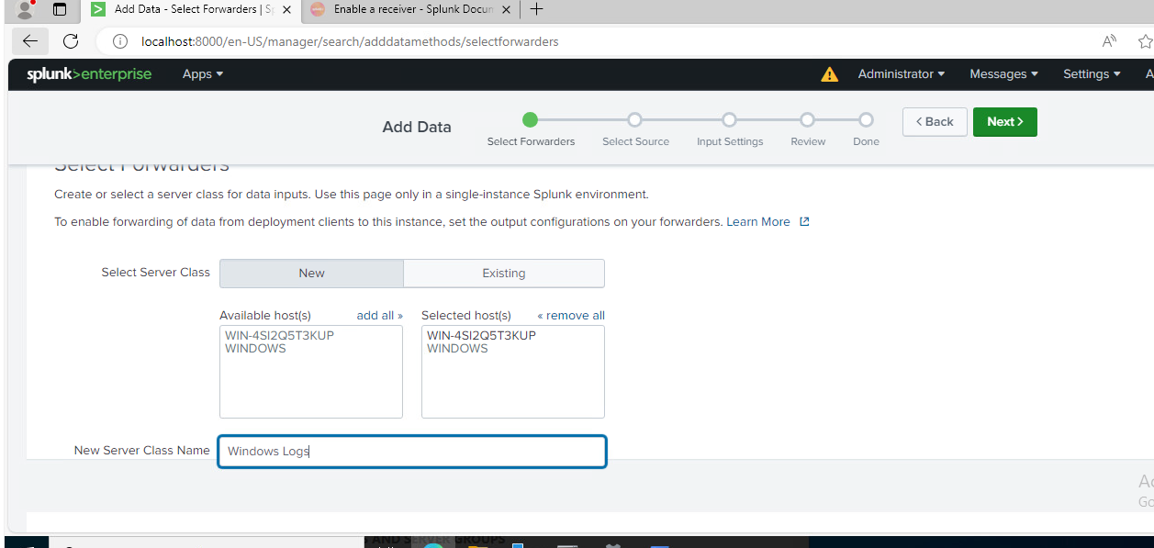
Add data to the index we created before on the host.
On settings select Add Data , and select the available forwarder endpoint. Has to give a class name to get data from the forwarder.

Slide 18
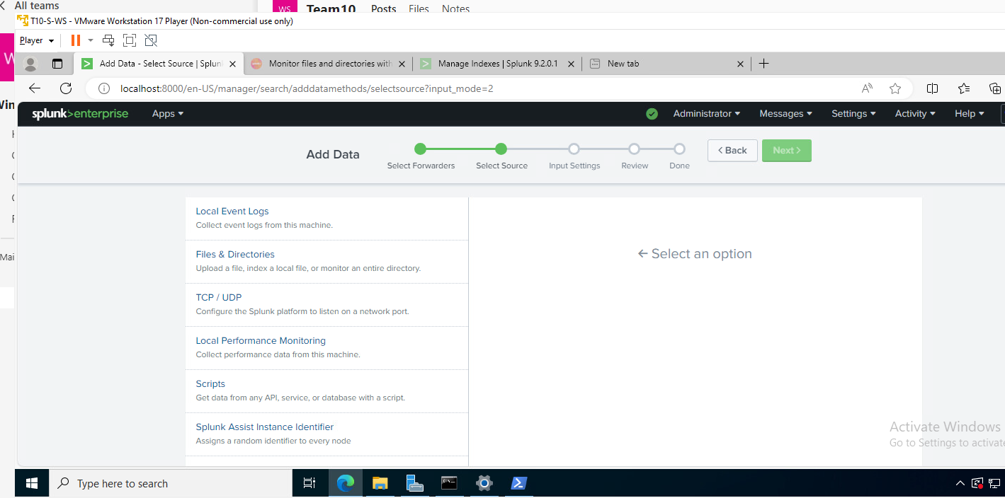
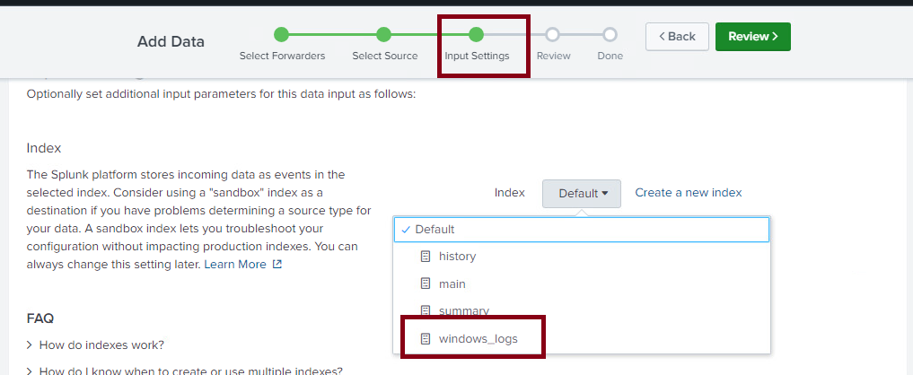
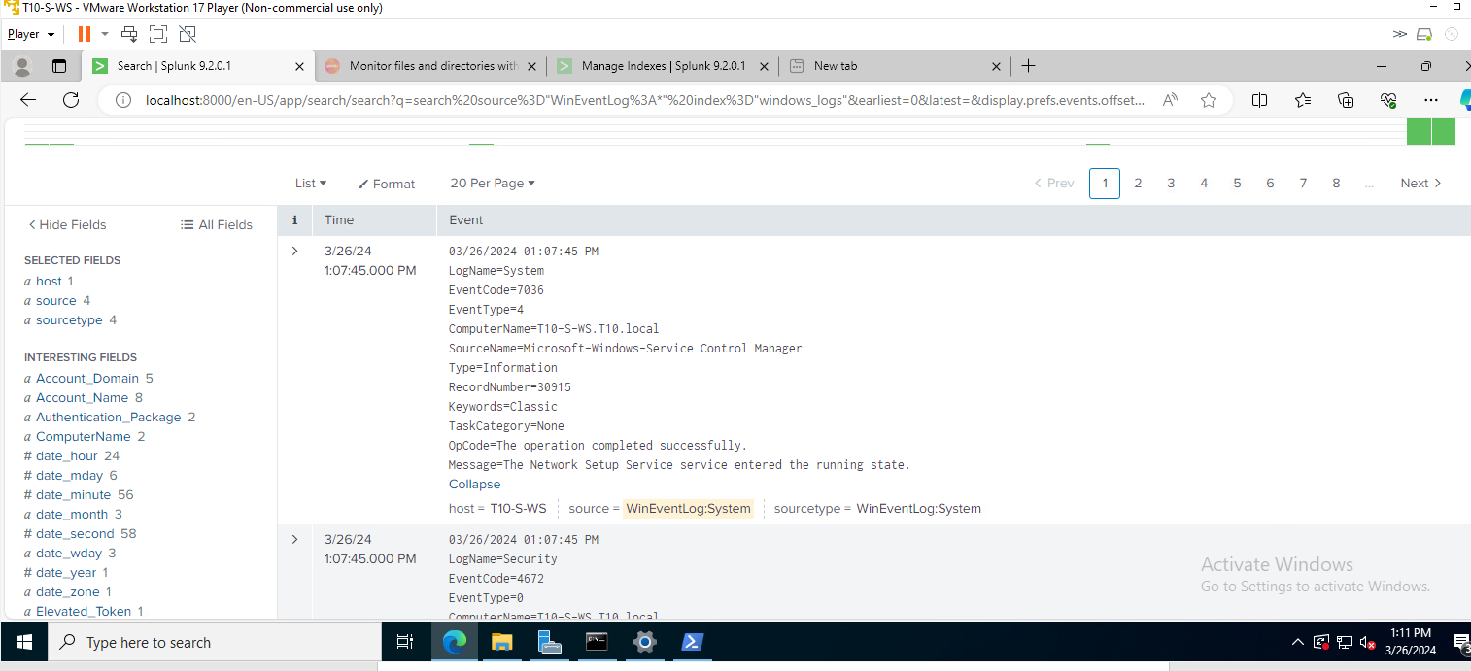
Add data to the index we created before on the host.
First select local events logs , and on the next step select the index we created before. After finishing select collect data and the collected data start to appear from the windows endpoint.

Slide 19
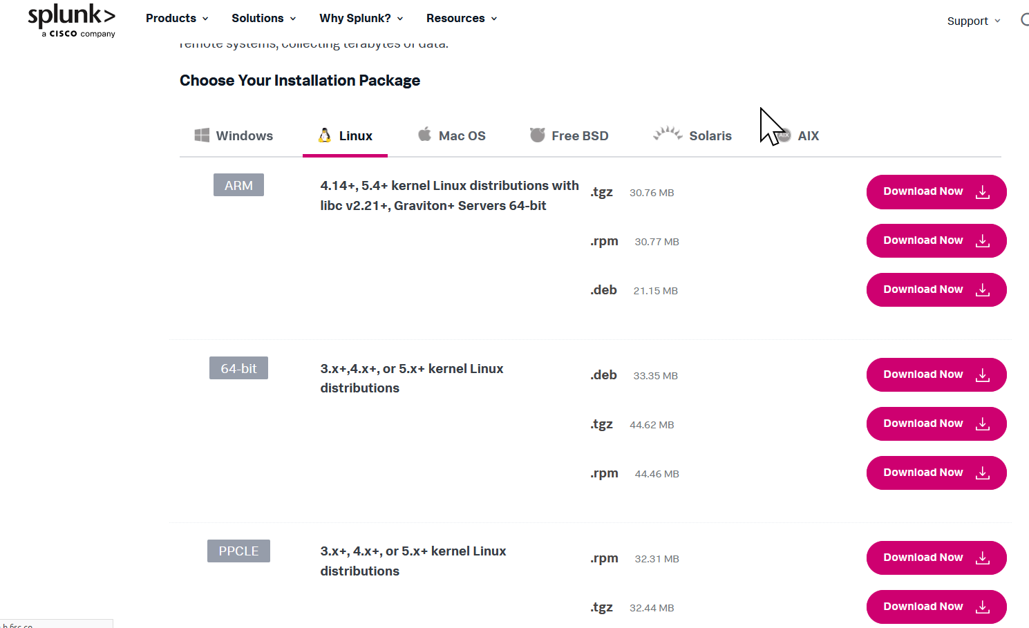
Alma Linux Universal Forwarder configuration.
Go to splunk web site, authenticate and select to download the right version for your Linux system We have Alma Linux, then we download 64 bit .rpm.

Slide 20
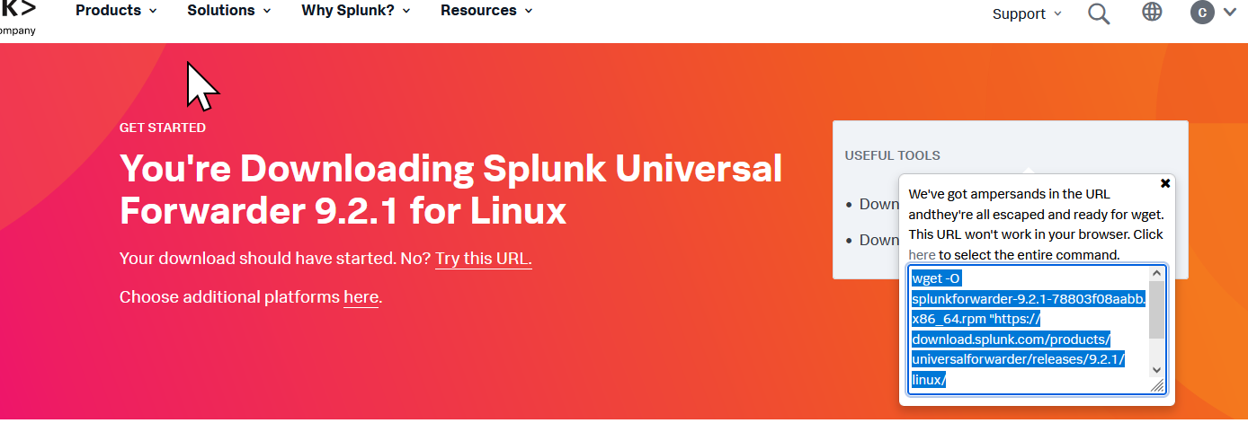
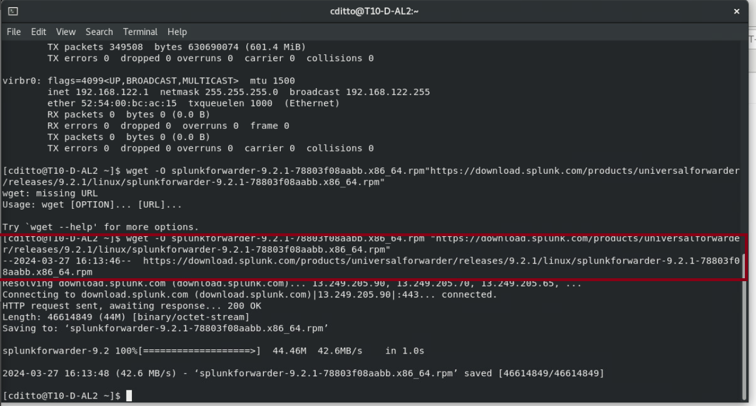
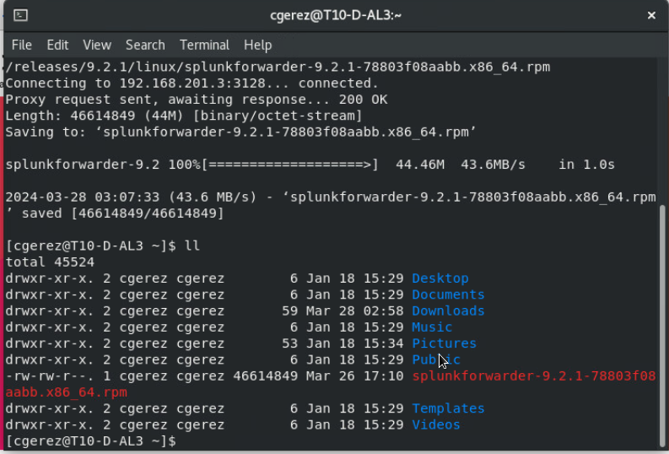
Alma Linux Universal Forwarder configuration.
Copy the script for the command line to download the file.
Use the script to download the file.
Review that the file was download with ll

Slide 21
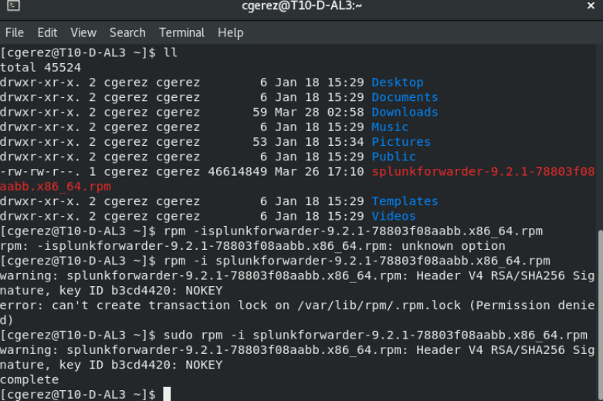
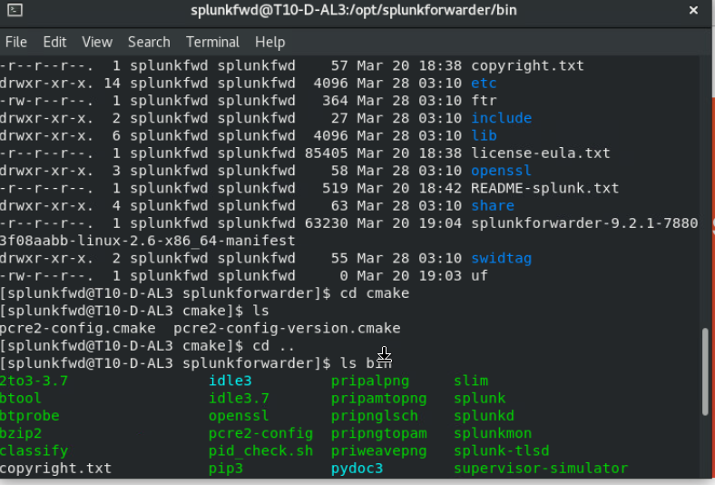
Alma Linux Universal Forwarder configuration.
Install the forwarder. Use:
sudo rpm -i and copy and paste the name of the file in red. Here you must change the user to continue, use:
su - splunkfwd
This user is created upon installation.
Then will be necessary to navigate to the right directory to perform enable start and configurations.
cd /opt/splunkforwarder/bin

Slide 22
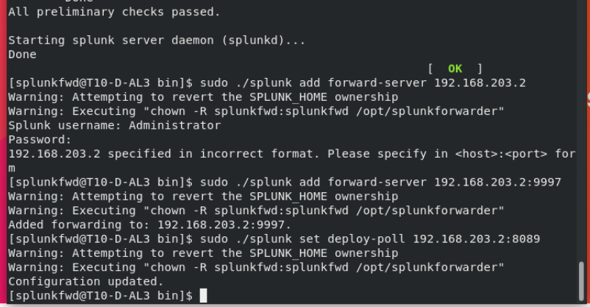
Alma Linux Universal Forwarder configuration.
To run the next commands use sudo and refers the splunk file with ./ as:
sudo ./splunk add forward-server 192.168.203.2:9997
And
sudo ./splunk set deploy-poll 192.168.203.2:8089

Slide 23
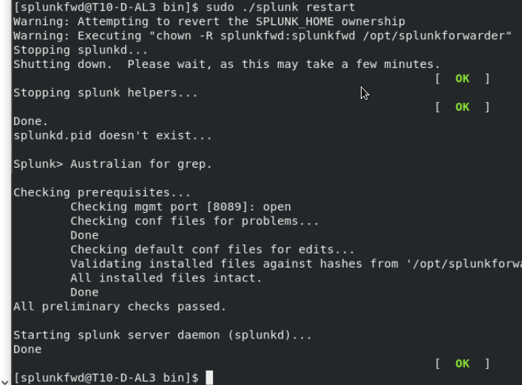
Alma Linux Universal Forwarder configuration.
Finally restart the service to make the new configuration available with:
sudo ./splunk restart

Slide 24
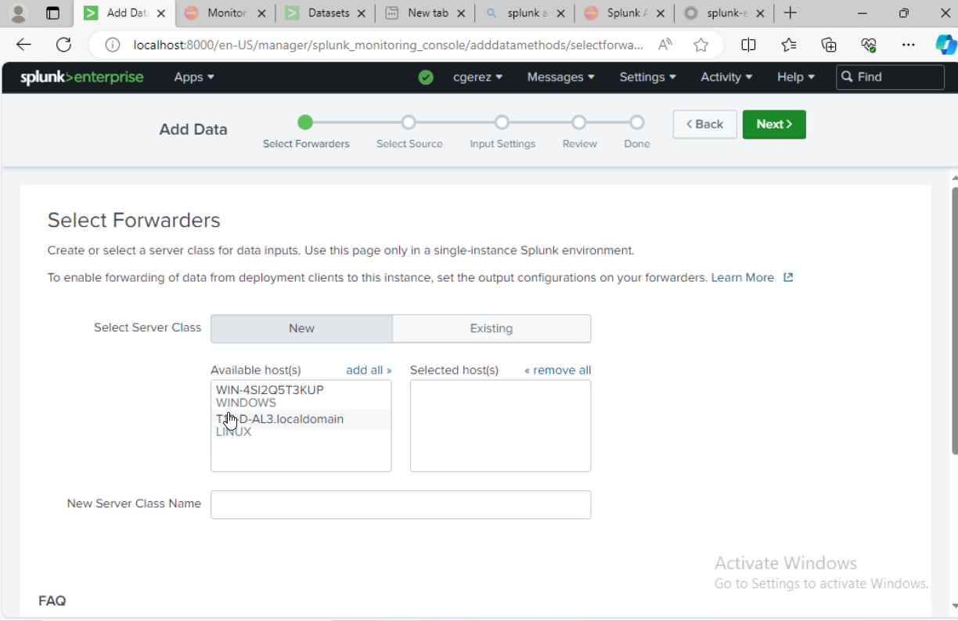
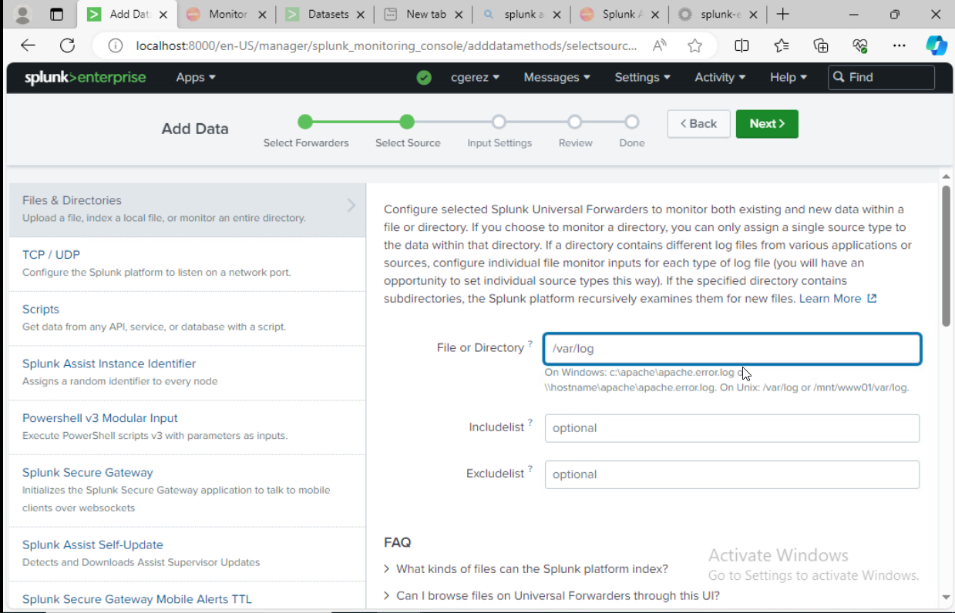
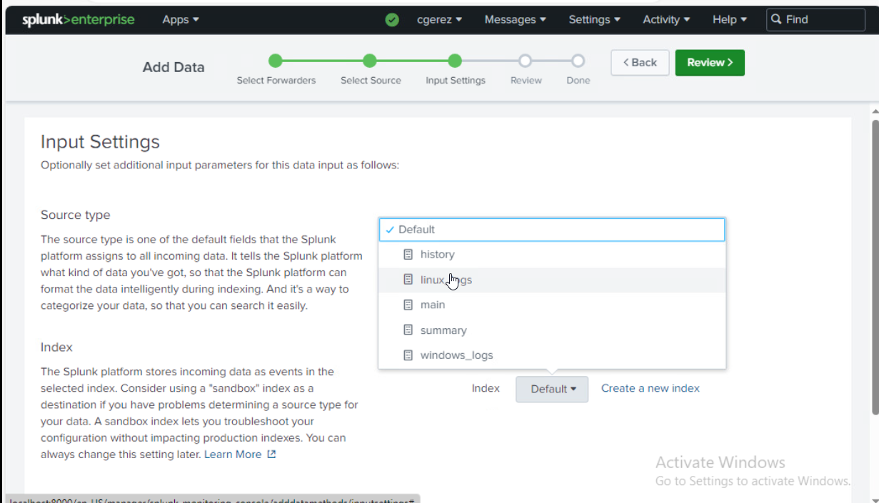
Received data from the new Linux forwarder.
On Add Data under settings on the host, select the new linux machine and add a class name.
Select files and directories to collect logs and set the path to:
/var/log/*
Use a previous created index for linux.

Slide 25
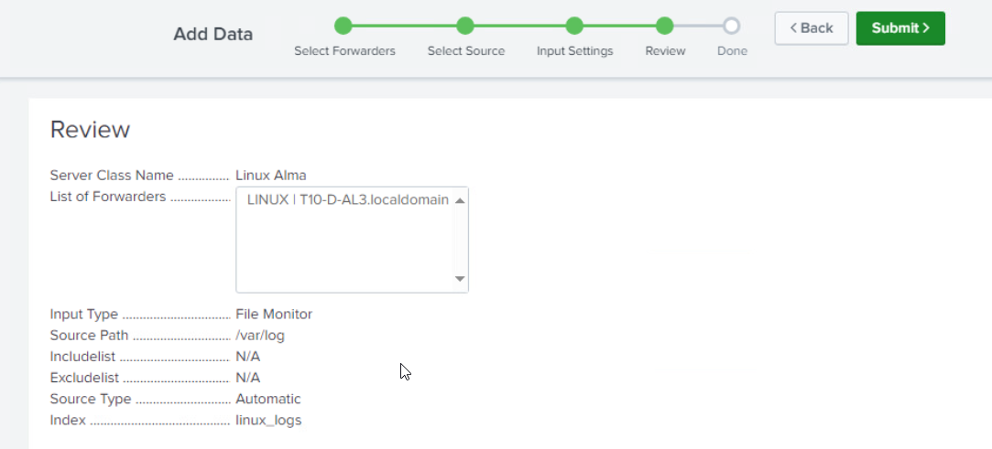
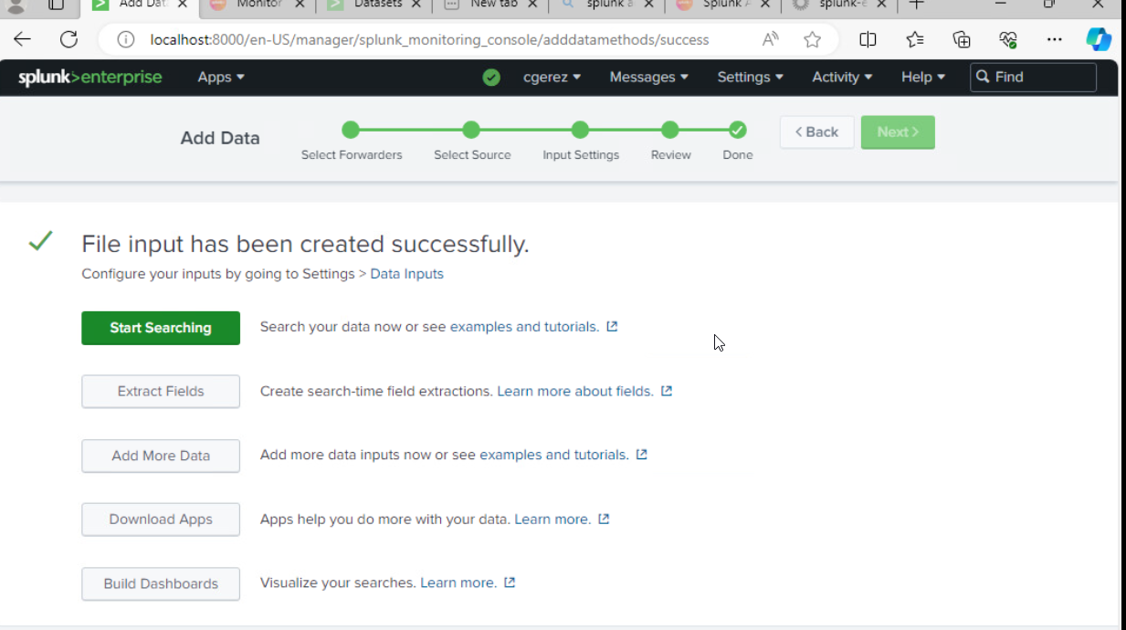
Alma Linux Universal Forwarder configuration.
Review and submit the search and start searching data in the next screen.

Slide 26

Alma Linux Universal Forwarder configuration.
Receiving log data from the linux machine.

Slide 27

Add users and passwords for the team on the host splunk enterprise.
Under settings locate the tab users to create users for the team.

